Slide 1
DSCI 401 Final Project
Brian Walsh

Slide 2
The Goals
Learn how to scrape data off the internet
Predict win-rates of certain characters in the video game “League of Legends“ based on statistics such as damage done, gold earned, etc.
Could be difficult since there’s a lot more that goes into a win condition than the data I have

Slide 3
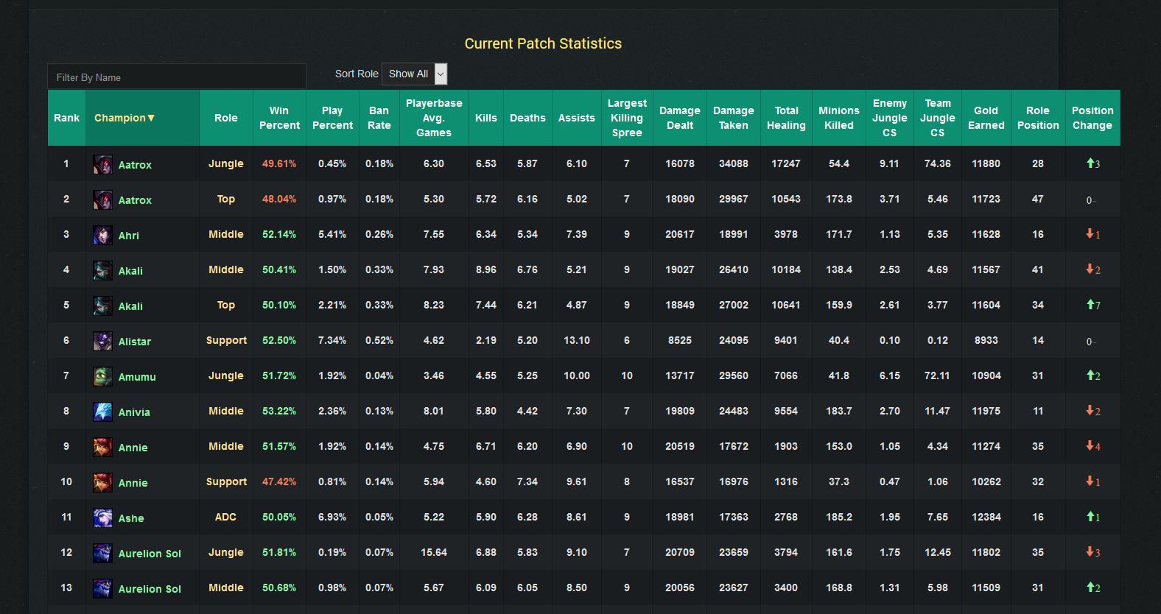

Slide 4
The Web-Scraper
There are online tools, but I wanted to learn how to do it myself
This part was a bit more complicated than I expected, since it wasn’t plain HTML
Web Scraper Program
cd c:\github\my_dsci_401
python scraper.py

Slide 5
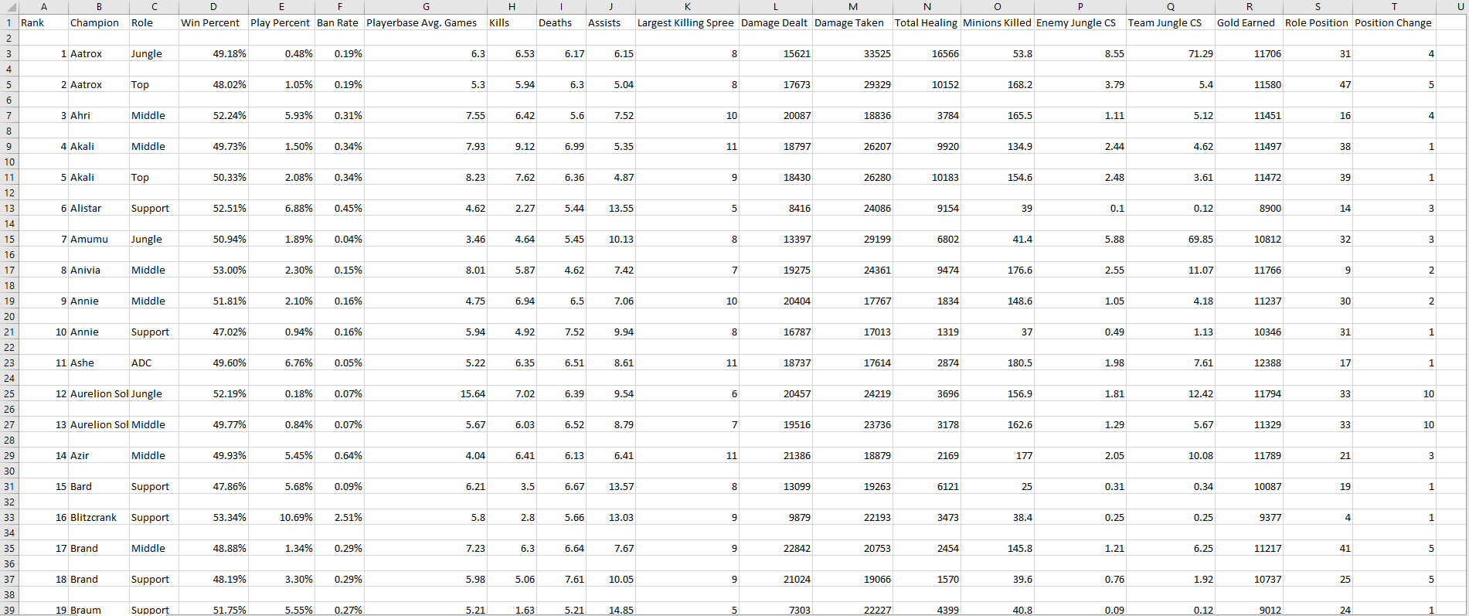
The Data

Slide 6
Building a Model
Used linear regression since I want to predict win-rate, not whether they will win
The evaluator I chose was the R2 score since that will make it easy to tell how well the model fits the data
Tried various preprocessing methods and models
Ended with a lasso model built from a GridSearch and cross-validated with 5 folds
Model building code

Slide 7
Results and Reflection
With a lasso model, I was able to achieve an R2 value of around .7
The nature of the data prevents it from ever being a perfect fit, however; with more data added about each character it could be possible to improve the fit
.7 is not a bad R2 score, and does indicate that my model can predict win rates to some degree of accuracy

